Slide 1
Energy Efficient Scheduling of Parallelizable Jobs
By: Kyle Fox, Sungjin Im, Benjamin Moseley
Presented By: Justin Rodriguez

Slide 2
The Problem

Slide 3
Two Competing Objectives
Job Scheduling: Scheduler must decide which resources (e.g., machines or processors) get allocated to what jobs over time
Objective 1: Minimize energy consumption by the system when scheduling jobs
Objective 2: Maximize quality of service with respect to the jobs being scheduled
Using less energy => fewer resources for jobs
How do we find an appropriate balance?

Slide 4
Old and New Solutions

Slide 5
Terminology to Know
Online Setting: Scheduler becomes aware of a job only after it arrives into the system, meaning it makes decisions over time without knowing future jobs.
Non-Clairvoyant: Scheduler is unaware of the processing times for jobs.
Speed Scaling: Processors available to scheduler are able to dynamically change their speed over time.
Flow Time: Amount of time that passes between a job’s start and completion time.

Slide 6
Online Speed Scaling Setting
Most Dominant energy aware scheduling model used in previous literature.
Goal: Minimize total flow time plus the energy consumed by the system.
Worth spending one unit of energy to save X units of flow time (minimize flow time leads to increase in average quality of service for jobs)
Introduction of a convex function P where P(s) is power consumed while running processor at speed s
Two Policies:
Job Selection: Decide what job should be scheduled at each step in time.
Energy Policy: Decide how fast to run processor(s) at each step in time

Slide 7
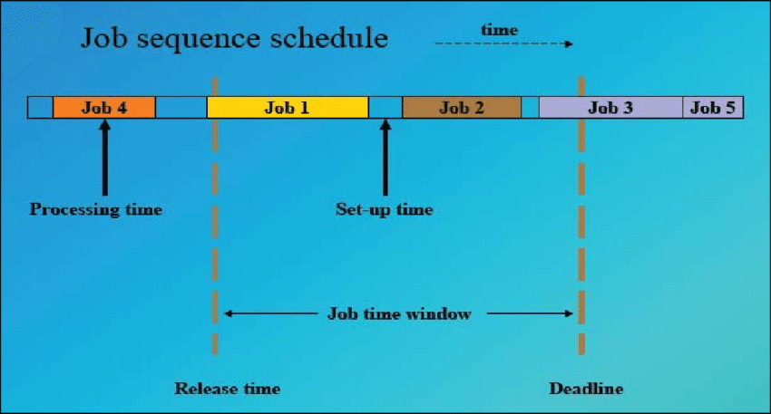
Scheduling On A Single Machine
Use a known algorithm which performs well on a single machine and pair with natural speed scaling policy.
Will run at speed s such that P(s) is proportional to number of unsatisfied jobs.
A balance is achieved between energy and flow time objectives as they will increase at roughly the same rate

Slide 8
Scheduling on Multiple Machines/Processors
Two models to Consider:
Each job is assigned at most one machine at each step in time.
  Naturally captures settings such as those of server farms
  With fixed speeds an energy is not an objective no algorithm can be O(1)-competitive for total flow time. Carries over to speed scaling w/ power function
  Turn to resource augmentation analysis: algorithm given extra resources and competitive ratio is bounded.
  An algorithm is b-speed c-competitive if algorithm with b-speed achieves objective value at most c times
  In speed scaling setting, when processor runs at power P(s) can process jobs at b*s speed.
  Goal is to find O(1)-competitive algorithm while using min amount of extra resources

Slide 9
Scheduling on Multiple Machines/Processors
Two models to Consider:
Each job is assigned at most one machine at each step in time.
Parallel scheduling
  Jobs scheduled on multiple processors at each moment in time
  Challenge occurs when there are different degrees of parallelizability
    Jobs have set of phases that are processed sequentially.
    Speed up will change depending on phase
    Require more computation or I/O
  Model referred to as arbitrary speed-up curves model

Slide 10
New Approach
Main Idea:”Non-clairvoyant arbitrary speed-up curves model where processors can be dynamically speed scaled”
Difference(s) From Previous Literature: Assume each algorithm knows how parallel each phase of job is. New functions for different phases of jobs.
Arbitrary Speed-Up Curves:
M uniform parallel machines/processors with jobs i that consist of multiple phases that require p amount of work
All machines are assumed to be uniform
Phases of jobs must be completed sequentially
At each point in time there is a feasible schedule in the model which allocates resources to unsatisfied jobs
Online scheduler has access to model and job’s weight
  Does not know size or remaining phases

Slide 11
New Approach
Extension To Dynamic Speed Scaling:
Each machine can be run faster/slower by changing power it consumes
Assume all machines processing same job consumes same amount of power
Keep objective of minimizing total weighted flow time plue total energy consumed
Do so by optimizing scaling speed at each phase of a given job for each machine

Slide 12
Results

Slide 13
Results
Paper deals in the theoretical
Function/Algorithm has not been implemented to a real world problem
Results section was used to prove their functions were mathematically sound
  Complex math with no easy way to apply them to real world situations/examples

Slide 14
Sources
http://www.andrew.cmu.edu/user/moseleyb/papers/energyParallel.pdf

